Slide 1


Slide 2










Slide 3




-
-
-
-

Slide 4



-
-
-
name
(
typed-parameter-list
)

Slide 5



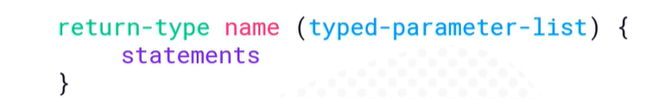
-
-
-
-
{

Slide 6



System.out.println(“Before method call”);
doSomething();
System.out.println(“After method call”);
Before method call
Inside method
Still inside After method call
static void doSomething() {
System.out.println(“Inside method”);
System.out.println(“Still inside”);
}

Slide 7







Slide 8

showSum(7.5, 1.4, 3);
static void showSum(float x, float y, int count) {
float sum = x + y; // sum: 8.9
for(int i = 0, i < count; i++)
System.out.println(sum);
Prints
3 times
}

Slide 9






Slide 10
10
val1
static void swap(int i, int j) {
int val1 = 10;
int val2 = 20;
swap(val1, val2);
20
int k = i;
i = j; j = k
// i:20 j:10
val2
10
i
20
j
System.out.println(val1) // 10
System.out.println(val2) // 20
10
}
k

Slide 11
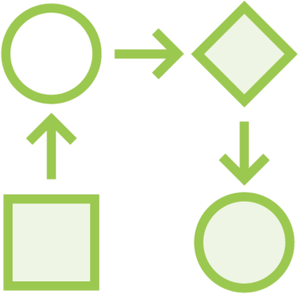









Slide 12

showSum(7.5, 1.4, 3); System.out.println(“Back from showSum”);
static void showSum(float x, float y, int count) {
float sum = x + y;
for(int i = 0, i < count; i++) System.out.println(sum);
return;
}

Slide 13
showSum(7.5, 1.4, 0); System.out.println(“Back from showSum”);
static void showSum(float x, float y, int count) {
float sum = x + y;
for( | int i = 0, |  | i < count | ; i++)
System.out.println(sum);
return;
}

Slide 14
showSum(7.5, 1.4, 0);
System.out.println(“Back from showSum”);
static void showSum(float x, float y, int count) {
if (count < 1)
return;
float sum = x + y;
for(int i = 0, i < count; i++) System.out.println(sum);
return;
}

Slide 15



-
-
-

Slide 16

double result = calculateInterest(100d, 0.05d, 10);
System.out.println(result); // 50.0
static double calculateInterest(double amt, double rate, int years) {
double interest = amt * rate * years;
return interest;
}

Slide 17
double result = calculateInterest(100d, 0.05d, 10);
System.out.println(result); // 50.0
static double calculateInterest(double amt, double rate, int years) { return amt * rate * years;
}

Slide 18

static double[] produceInterestHistory(double amt, double rate, int years)
{
double[] accumulatedInterest = new double[years]; for(int yearIndex = 0; yearIndex < years; yearIndex++) {
int year = yearIndex + 1;
accumulatedInterest[yearIndex] = calculateInterest(amt, rate, year);
}
return accumulatedInterest;
}

Slide 19









Slide 20



java com.mycompany.example.Main Hello “Mary Ann”
public static void main(String[] args) {
if(args.length < 1) System.out.println(“No args provided”);
else
for(String arg : args)
System.out.println(arg);
}

Slide 21
java com.mycompany.example.Main Hello “Mary Ann”
public static void main(String[] args) {
if(args.length < 1)
System.out.println(“No args provided”);
else
Hello
Mary Ann
for(String arg : args)
System.out.println(arg);
}

Slide 22


-
-
-

Slide 23
-
-
-
-

Slide 24






-
-
-
-
-

